Slide 1

Eating Along with CTA Metra in Chicago
Xia sheng
4/12/2020

Slide 2

Xia Sheng
IBM Data Science Learning
The Final Assignment

Slide 3

Chicago
Chicago is the 3rd largest cities in the US. With the convenient CTA service people could easily get all different kind foods. Today we use data to do a research about the food along with CTA Metra

Slide 4

Overview
Chicago Introduce
Original Data
Data Pre-procession
Data Regression
Conclusion

Slide 5
Original Data
CTA L rail station CSV files from https://data.cityofchicago.org/Transportation/CTA-System-Information-List-of-L-Stops/8pix-ypme
The venues information data we use Foursquare API

Slide 6
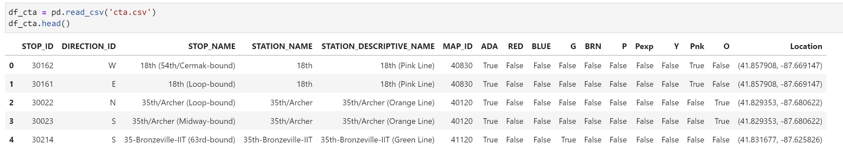
CTA Rail Station Data
We read the ‘cta.csv’ file through pandas.
We need the STATION_NAME and the location.
The location is string form, we could use literal_eval to transfer string into tuple

Slide 7
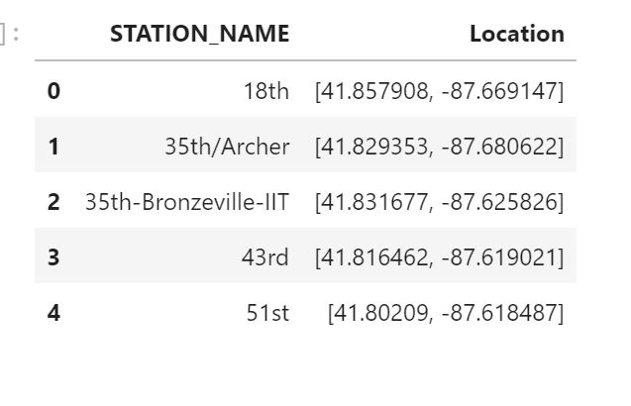
After Data Pre-processing
The original CSV file is based on the lines, the station_names are duplicated.
After we drop the duplicated rows and change the data type about the location.

Slide 8
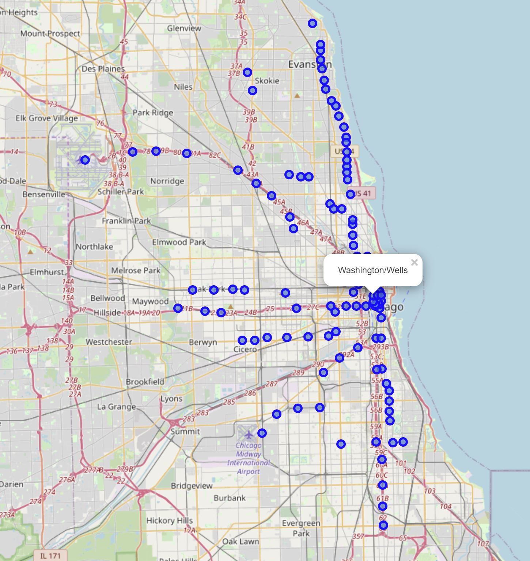
Put the Station on map with Folium

Slide 9
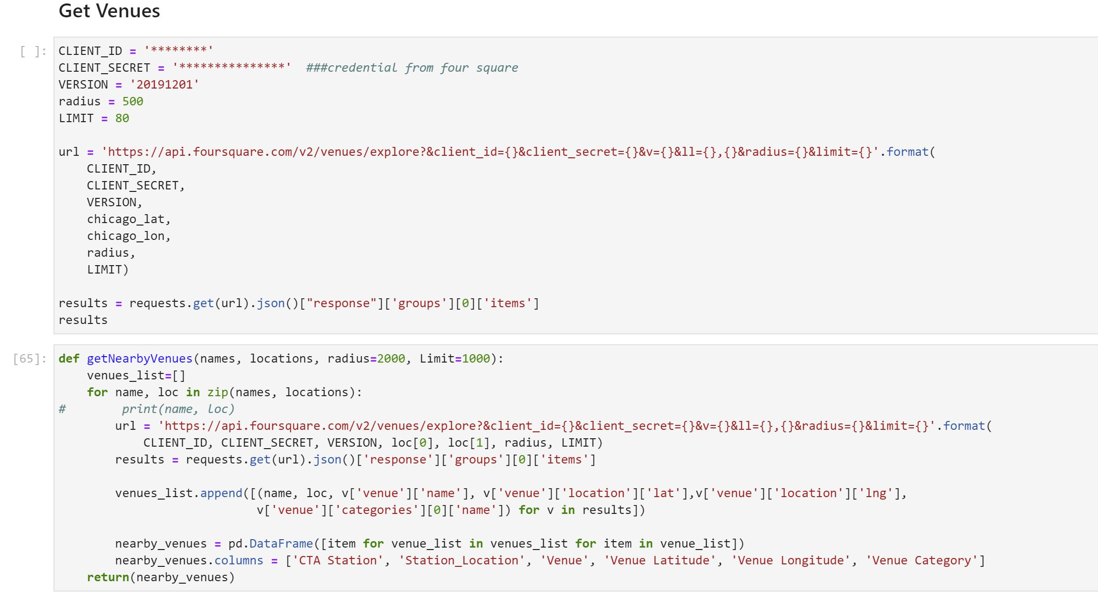
Venues along the CTA Metra
With Foursquare API’s help, we can get the most venues information along the CTA rail.

Slide 10
KMean Clustering
What is the Kmean Clustering
Implement of Kmean Clustering
Find the K

Slide 11
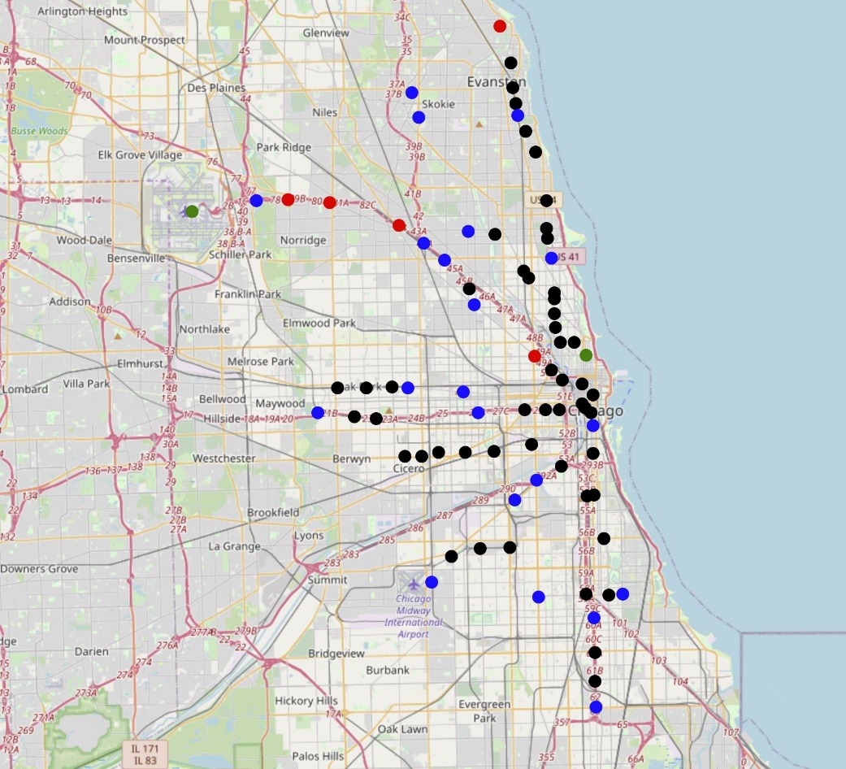
Find the K, plotting on the map

Slide 12
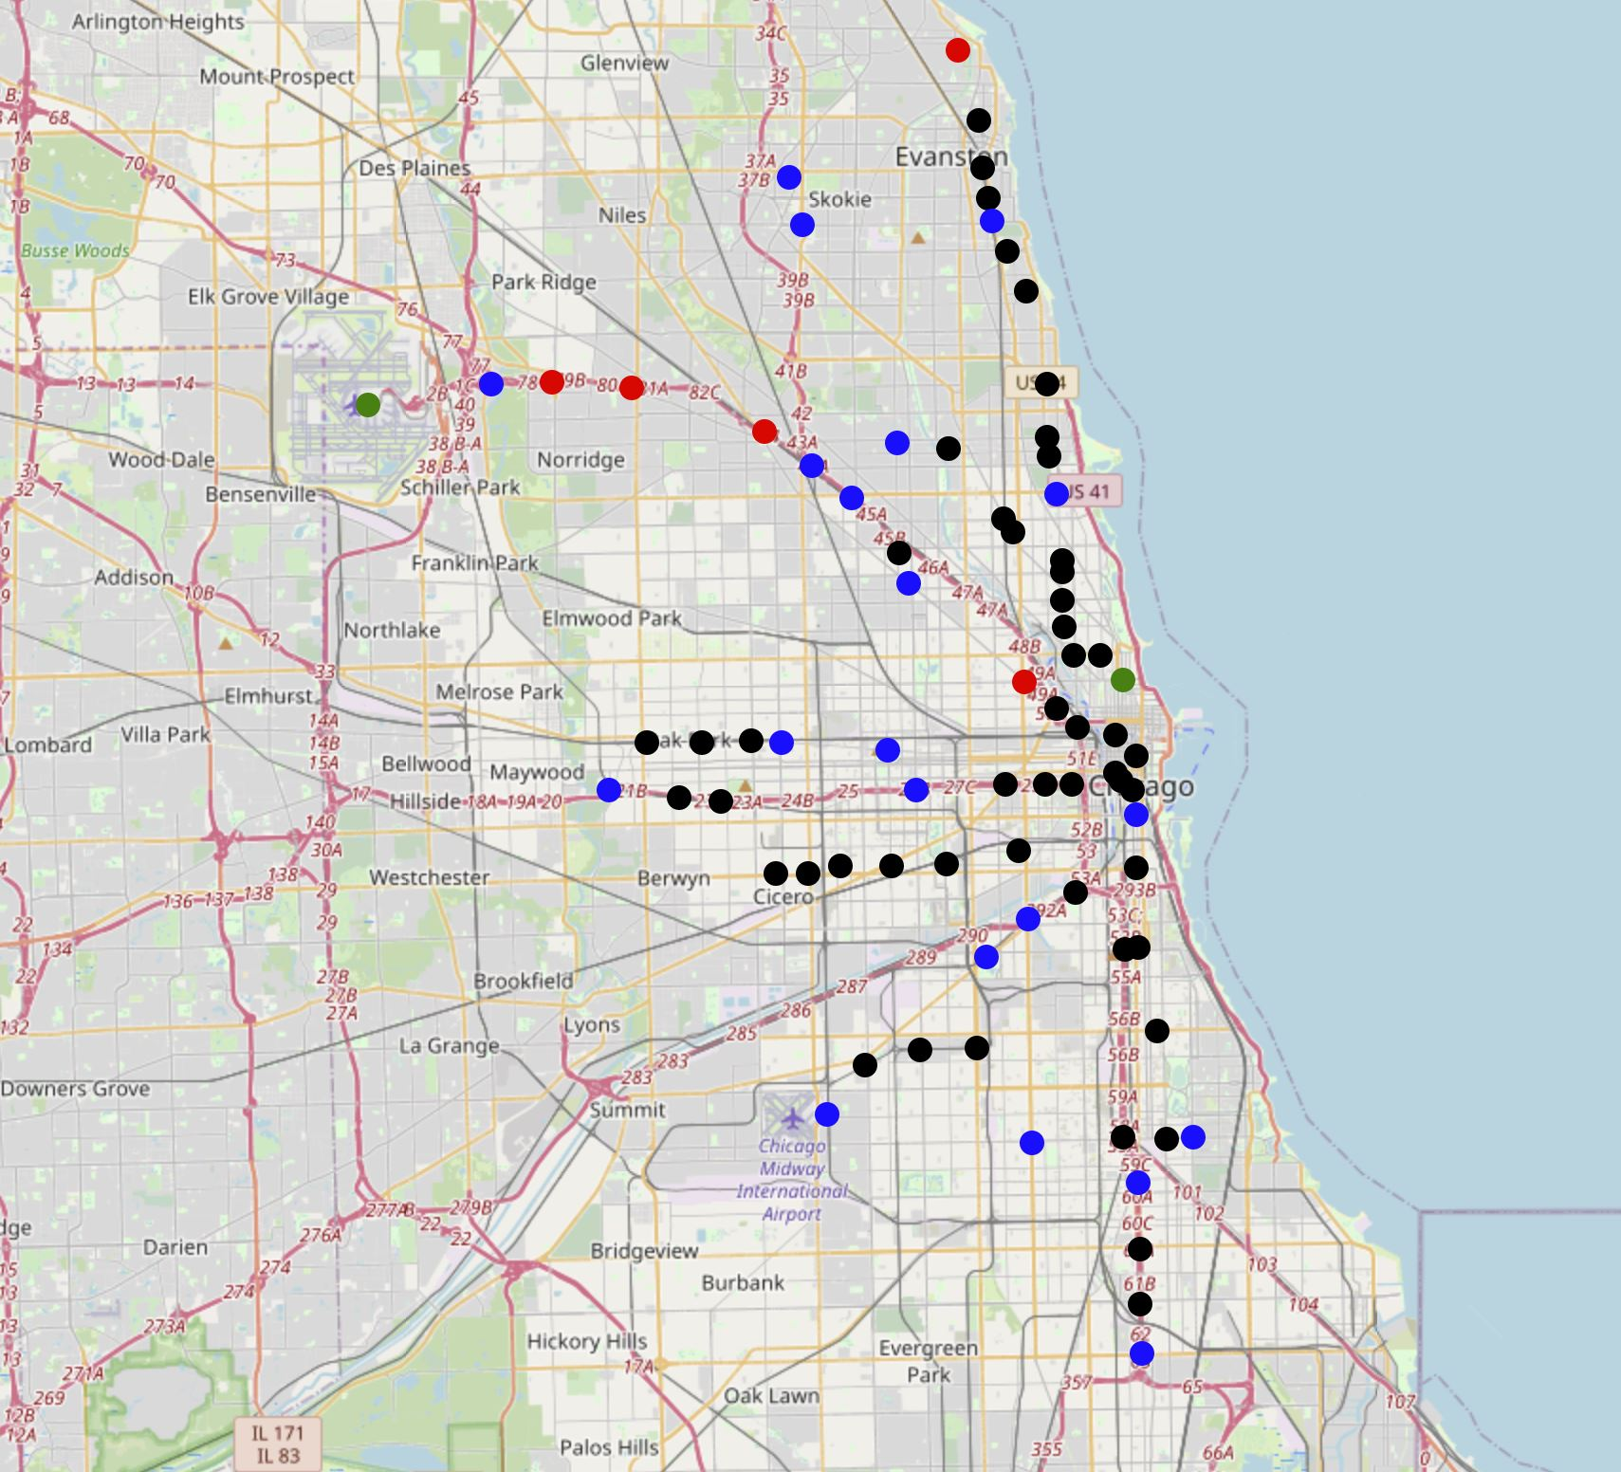
Restaurants on the map

Slide 13
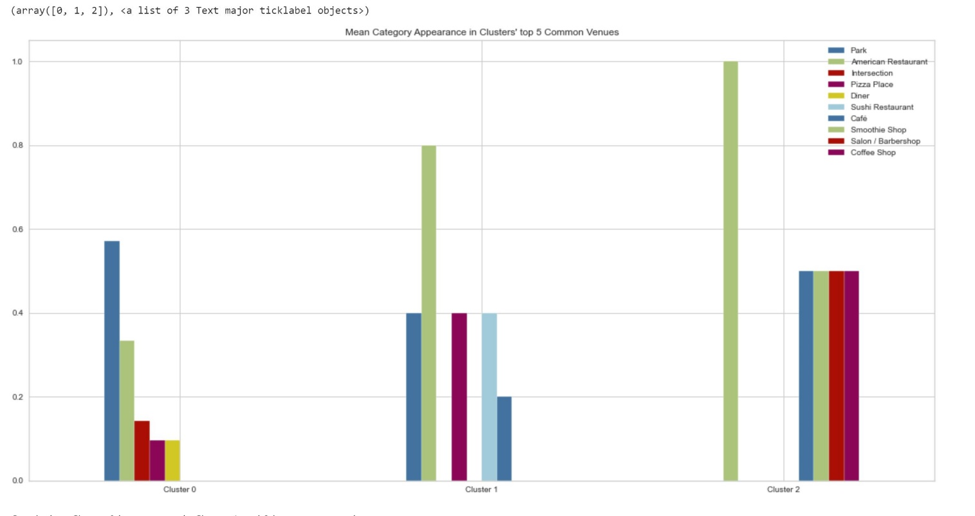
Conclusion

Slide 14

Thank You

